Slide 1
How to use this PowerPoint
This PowerPoint introduces our Story Deck cards by showing how you could use them with some examples of TV shows, films and music. Before using it, please do check the slides to make sure you’re happy with the examples, as some may only be appropriate for older pupils. See the notes of each slide for age ratings for films and television. We also highly encourage you to add in any media you know your pupils love whether books, films, TV shows or games. Remember, there’s no correct way to use the cards, so use your own interpretation.
scottishbooktrust.com

Slide 2
Introducing Story Deck
scottishbooktrust.com

Slide 3
What is Story Deck?
Story Deck is a deck of cards you can use to talk about the kinds of stories you do (or don’t!) like.
Including:
Books
Films
TV shows
Video games
Podcasts
Music
scottishbooktrust.com

Slide 4
What do the cards mean? (1)
Simply put, the cards mean whatever you think they mean. All of them are open to your interpretation and there’s no right or wrong way to use them. The card could make you think of a character, genre, setting, atmosphere, theme – or anything else that pops into your head!
scottishbooktrust.com

Slide 5
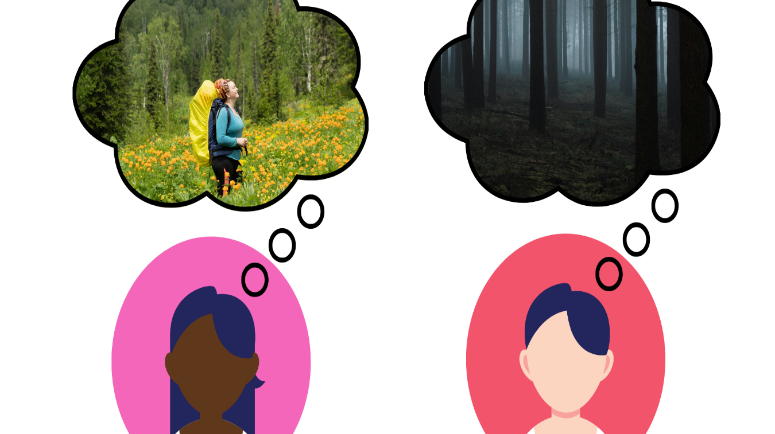
What do the cards mean? (2)
For example, imagine you ask two people to imagine a forrest. One person might think about going hill-walking surrounded by animals. The other, might think about being stranded somewhere dark and scary…
scottishbooktrust.com

Slide 6
What do the cards mean? (3)
That’s the same as this card:
scottishbooktrust.com

Slide 7
Some examples
Now that you’ve heard a bit about how the cards can be used, here’s some examples with some books, TV shows and music you may be familiar with. Remember: someone else may choose different cards to represent these stories. If you disagree, you could suggest your own changes!
scottishbooktrust.com

Slide 8
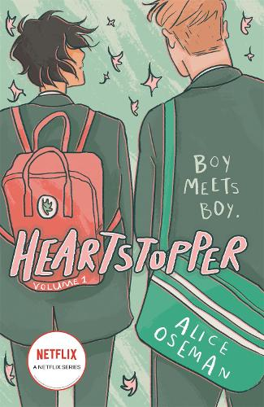
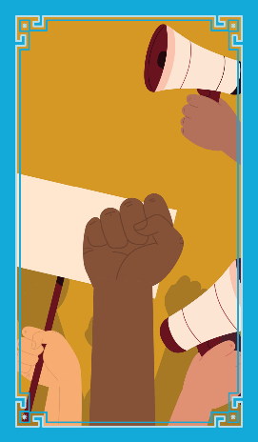
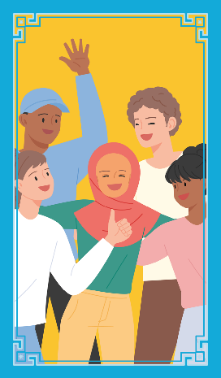
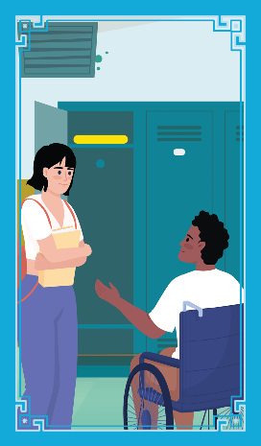
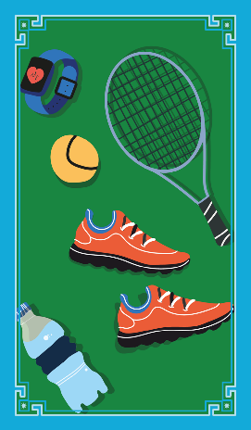
Heartstopper by Alice Oseman
scottishbooktrust.com

Slide 9
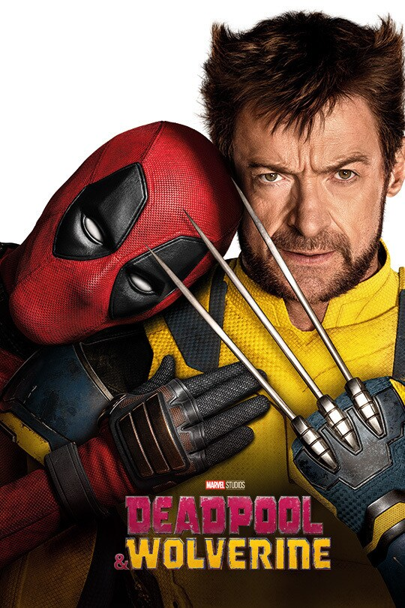
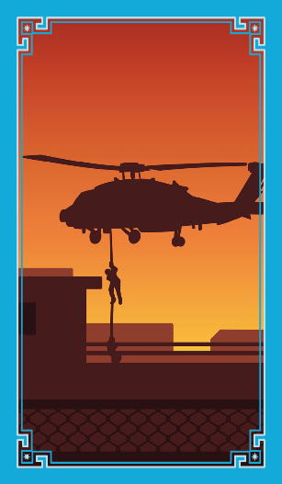
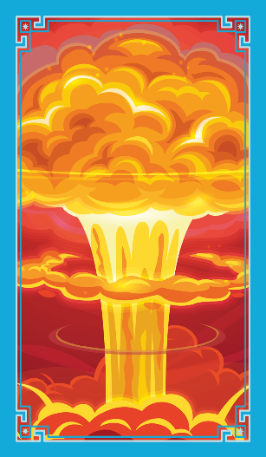
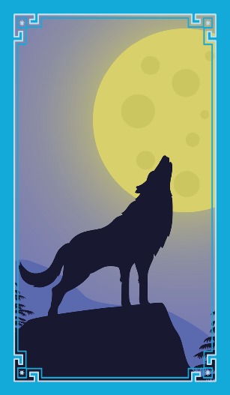
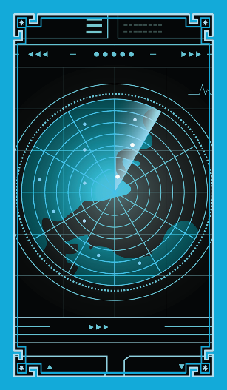
Deadpool and Wolverine
scottishbooktrust.com
Notes:
Please note: this film has an age rating of 15.

Slide 10
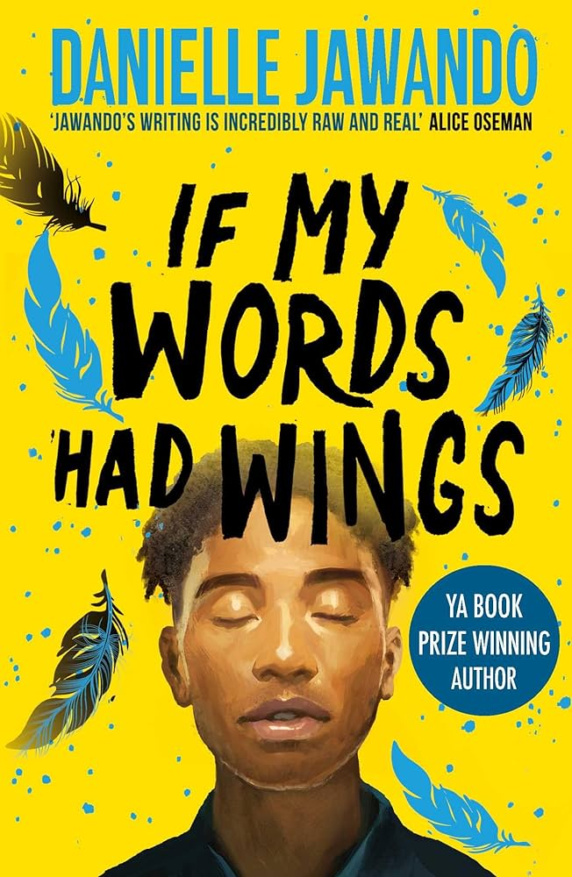
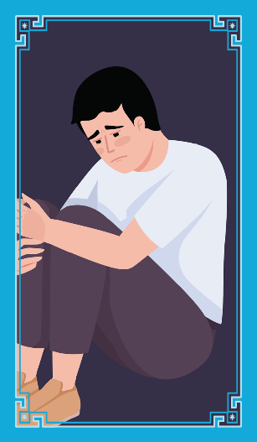
If My Words Had Wings by Danielle Jawando
scottishbooktrust.com
Notes:
Please note, there are themes in this book that mean it may not be suitable for younger readers. For more information, see: https://www.scottishbooktrust.com/learning-resources/read-scottish-teen-books

Slide 11
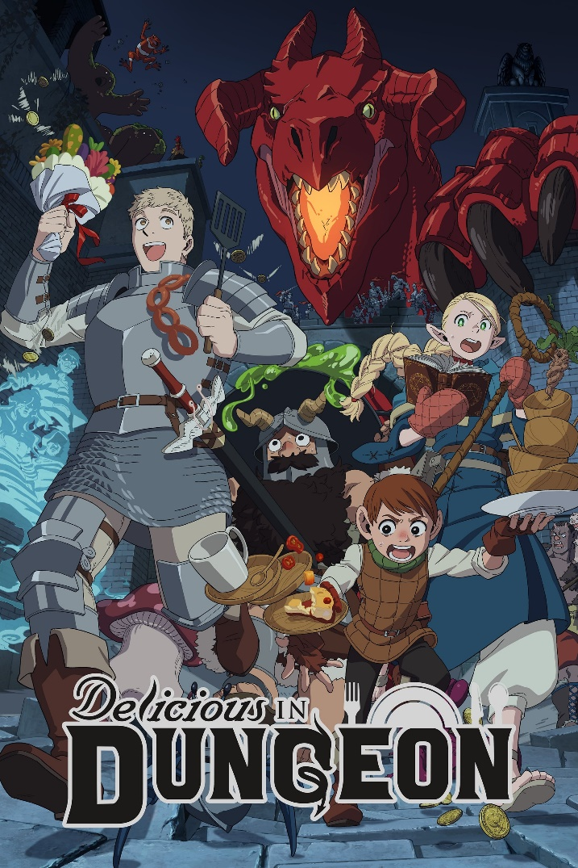
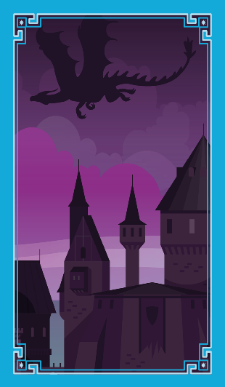
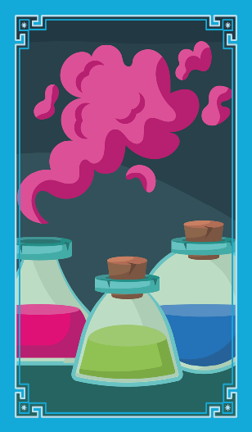
Delicious in Dungeon
scottishbooktrust.com
Notes:
Please note: this anime has an age rating of 15.

Slide 12
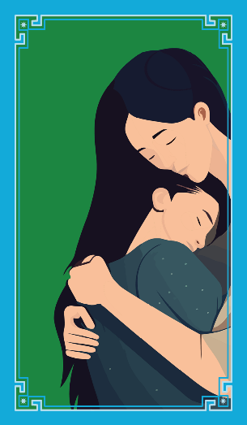
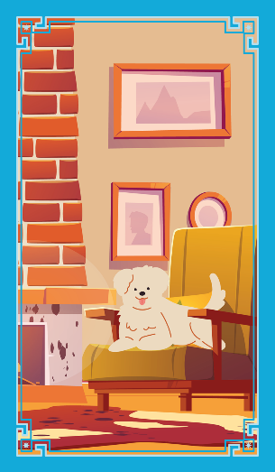
A Kind of Spark by Elle McNicol
scottishbooktrust.com

Slide 13
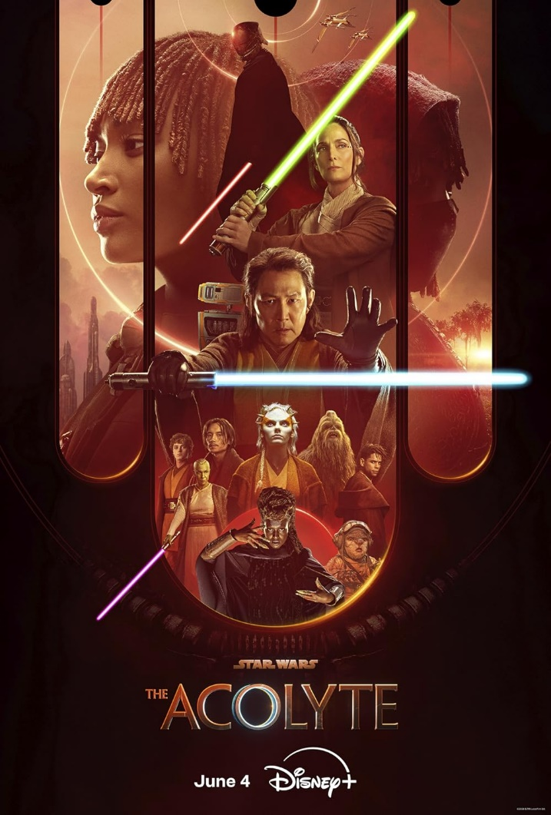
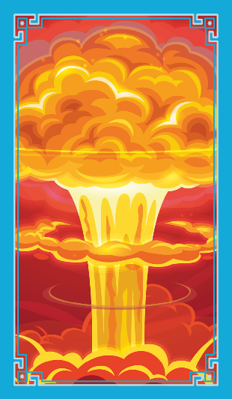
Star Wars: Acolyte
scottishbooktrust.com
Notes:
Please note: this TV show has an age rating of

Slide 14
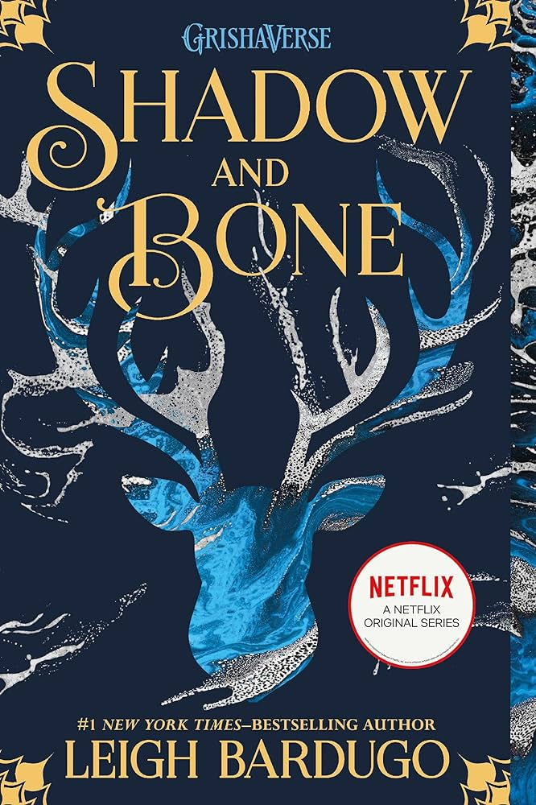
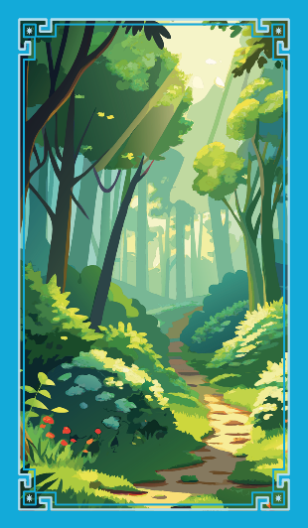
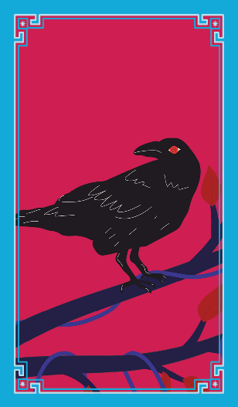
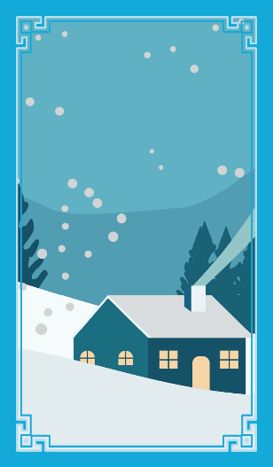
Shadow and Bone by Leigh Bardugo
scottishbooktrust.com

Slide 15
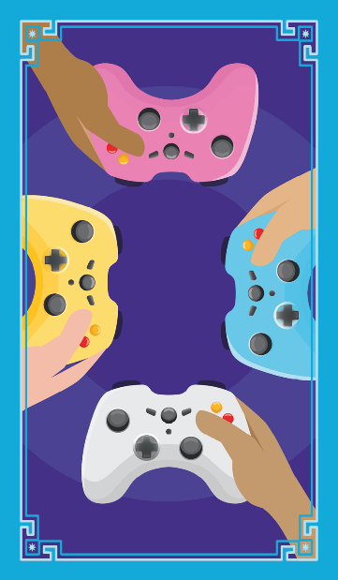
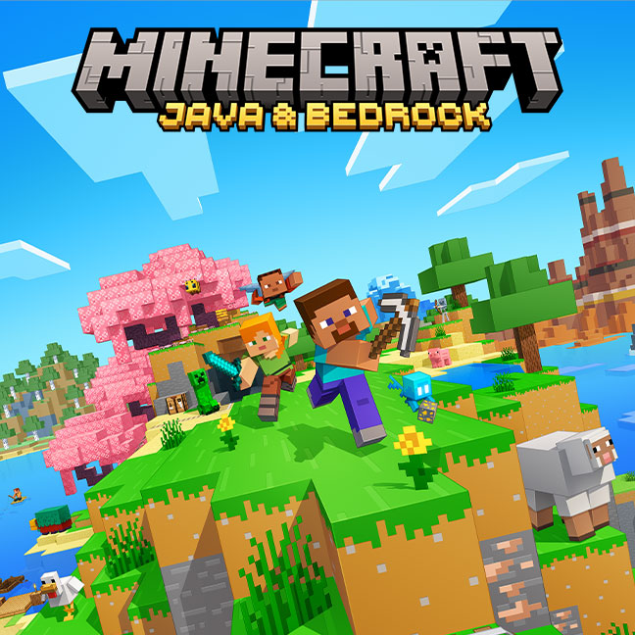
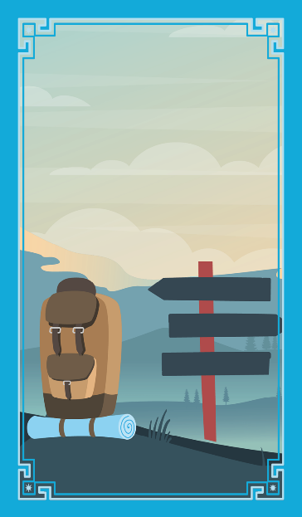
Minecraft
scottishbooktrust.com

Slide 16
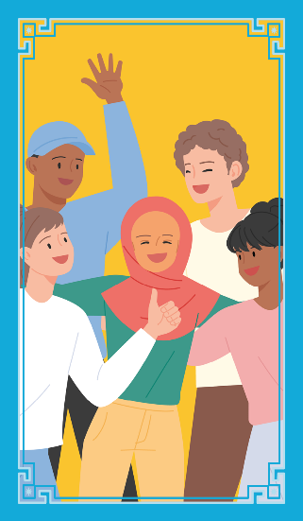
Northern Soul by Phil Earle
scottishbooktrust.com

Slide 17
The Hunger Games
scottishbooktrust.com
Notes:
Please note: this film has an age rating of 12.

Slide 18
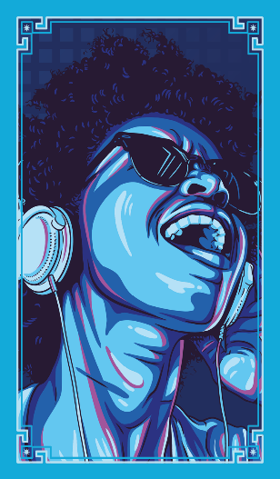
The Eras Tour by Taylor Swift
scottishbooktrust.com
Notes:
Please note this film has an age rating of 12.

Slide 19
Your turn!
In pairs or groups, recommend something you’ve enjoyed recently, using the cards to describe it. Remember, there’s no “correct” way to interpret the cards. Just go with your instincts!
scottishbooktrust.com

Slide 20
Thank you
scottishbooktrust.com
Scottish Book Trust is a national charity changing lives through reading and writing. Registered company SC184248 | Scottish charity SC027669

